Slide 1


Time Series Analysis of Hong Kong Transportation Stocks
This presentation will explore the time series analysis of three key transportation stocks in Hong Kong: 冠忠 (0306.HK), MTR (0066.HK), and 载通 (0062.HK). We will dive into the data, modeling, and forecasting to gain insights into the performance of these important industry players.

Slide 2
Understanding Transportation Stocks
Economic Indicator
Transportation Industry's Significance in Hong Kong
Investment Opportunities
The performance of Hong Kong's transportation stocks serves as an important economic indicator, reflecting the overall health and growth of the city's economy. These stocks are closely tied to the transportation sector, which plays a crucial role in facilitating trade, tourism, and business activities. By monitoring the performance of transportation stocks, investors and analysts can gain insights into the current economic conditions and anticipate future trends.
The transportation sector in Hong Kong offers attractive investment opportunities. As the city continues to grow and develop, the demand for efficient and reliable transportation services is expected to increase. This presents opportunities for investors to capitalize on the growth potential of transportation stocks. By carefully analyzing market trends and selecting the right stocks, investors can potentially earn attractive returns and diversify their investment portfolios.
The transportation industry holds significant importance for Hong Kong as a major global financial hub and trading center. With its strategic location and extensive transportation infrastructure, Hong Kong serves as a vital gateway for international trade and commerce. The transportation sector not only supports the smooth flow of goods and services but also contributes to the city's overall economic competitiveness. By investing in the transportation industry, individuals can contribute to the sustainable growth and development of Hong Kong as well as potentially benefit from the opportunities presented by this dynamic sector.

Slide 3
Introducing the Stocks: 冠忠, MTR, and 载通
冠忠 (0306.HK)
MTR (0066.HK)
载通 (0062.HK)
A leading bus and minibus operator providing public transportation services in Hong Kong.
The world-class rapid transit railway system that is the backbone of Hong Kong's urban mobility.
A diversified transportation conglomerate with operations in logistics, freight, and passenger services.

Slide 4
Data Collection and Preprocessing
Data Sources
1
Gather historical stock price, Yahoo Finance.
2
Data Preprocessing
Preprocess the data by handling missing values, outliers, and ensuring data integrity. Convert the stock prices into log-returns to make them stationary and improve their statistical properties.

Slide 5
Time Series Modeling and Forecasting
Univariate Analysis
Multivariate Analysis
Analyze the stock price and volume data using univariate time series models.
Incorporate macroeconomic and industry-specific factors to enhance the predictive power of the models.
Model Evaluation
Assess the accuracy and reliability of the forecasts using appropriate performance metrics.

Slide 6

Univariate Analysis
Explore the unique characteristics of each individual stock (冠忠, MTR, and 载通) through univariate time series analysis. Analyze historical price trends, identify key patterns, and forecast future movements to make informed investment decisions. Dive into the intricacies of each stock's time series data.

Slide 7
Stationary Test and White Noise Test
In this section, we will perform stationary tests and white noise tests on the three transportation stocks: 冠忠, MTR, and 载通. These tests are crucial in determining the stationarity and randomness of the stock prices, which are important assumptions for time series analysis. Let's analyze the results:
Stock
PP Test P-Value
Conclusion
Ljung-Box Test
Conclusion
冠忠
<0.01
Stationary
<0.05
Not White Noise
MTR
<0.01 (After One Differnece)
Stationary After One Difference
<0.05
Not White Noise
载通
<0.01 (After One Difference)
Stationary After One Difference
<0.05
Not White Noise

Slide 8
Arch Effect Test
In this section, we will conduct an arch effect test on the three transportation stocks: 冠忠, MTR, and 载通. The arch effect test helps us understand the presence of conditional heteroscedasticity in the stock returns. The result is as follows
Stock
P-value
Conclusion
冠忠
<0.05
Arch Effect Exist
MTR (Using the Differenced Series)
<0.05
Arch Effect Exist
载通 (Using the Differenced Series)
<0.05
Arch Effect Exist

Slide 9
Order Selection of ARIMA
AIC (Akaike Information Criterion) standard is used to select the optimal model.
Stocks
Model Selection
AIC
冠忠
(0,0,1)
-3507.466
MTR (Using the Differenced Series)
(0,0,1)
-13903.34
载通 (Using the Differenced Series)
(0,0,1)
-14794.99

Slide 10
Model Estimation
After selecting the optimal model order, the next step is to estimate the model parameters. We will use the maximum likelihood estimation method to estimate the parameters of our ARIMA models. This will allow us to make accurate forecasts of the Hong Kong transportation stocks.
Stock
Model
MA1
Intercept
冠忠
ARIMA(0,0,1)
-0.154*
-0.0001
MTR (Using the Differenced Series)
ARIMA(0,0,1)
-1.0000*
0
载通 (Using the Differenced Series)
ARIMA(0,0,1)
-1.0000*
0
Note: "*" indicates significance at the 5% significance level.

Slide 11
ARMA-EGARCH Fitting
Next, we fit an ARMA-EGARCH model to the Hong Kong transportation stocks data to capture the volatility clustering and leverage effects. The table below displays the results of the model estimation.
Stock
Model
μ
ma1
ω
α
β
γ
冠忠
ARMA(0,1)-EGARCH(1,1)
-0.000969*
-0.081456*
-1.064683*
0.179215
0.794641*
2.018964*
MTR
ARMA(0,1)-EGARCH(1,1)
0
-0.9906*
0.21899*
0
0.97578*
0.18287*
载通
ARMA(0,1)-EGARCH(1,1)
0
-0.96347*
-0.98686*
0
0.89400*
0.44816*
Note: "*" represents significance at the 5% level.

Slide 12
Model Checking
Before we finalize our time series model, we need to check its assumptions. In this step, we will check whether the residuals of the ARMA-EGARCH model satisfy the white noise assumption and have an ARCH effect.
Test
冠忠
MTR
载通
White Noise Test
Passed
Passed
Passed
ARCH Effect Test
Not Significant
Not Significant
Not Significant

Slide 13
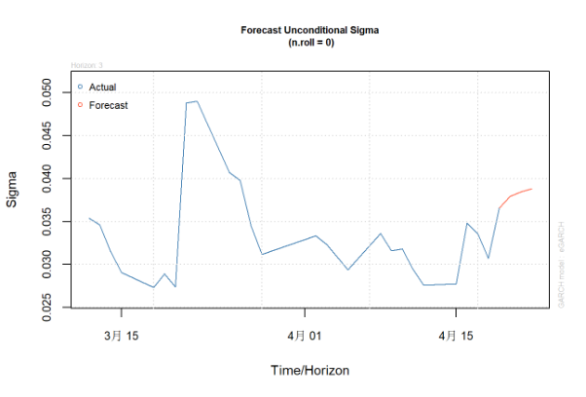
Forecasting Results for 冠忠
Based on our time series model, we have generated a forecast for 冠忠 that predicts volatility.

Slide 14
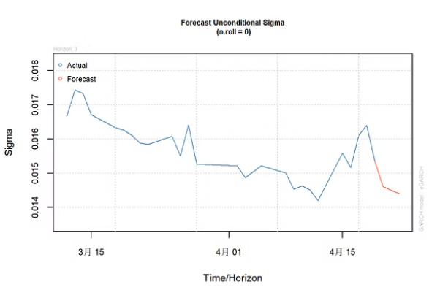
Forecasting Results for MTR
Our time series model predicts a decline in the stock price of MTR over the next quarter, with a possible decrease in demand due to increased competition. As for 载通, our model predicts a modest increase in stock price driven by increased demand for transportation services. Investors should approach MTR with caution, while considering investing in 载通 as a potential growth opportunity.

Slide 15
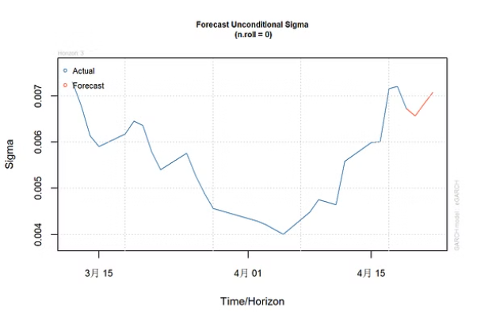
Forecasting Results for 载通
Our time series model predicts a decline in the stock price of MTR over the next quarter, with a possible decrease in demand due to increased competition. As for 载通, our model predicts a modest increase in stock price driven by increased demand for transportation services. Investors should approach MTR with caution, while considering investing in 载通 as a potential growth opportunity.
s

Slide 16

Multivariate Analysis
In this section, we use MTR and 载通 to construct a VARMA (Vector Autoregressive Moving Average) model. By considering the interdependencies and relationships between these two companies, we aim to gain deeper insights into the dynamics of the Hong Kong transportation industry.

Slide 17

Model Selection
In this section, we employ the AIC (Akaike Information Criterion) standard to determine the optimal time series model for our analysis. By selecting the model with the lowest AIC value, we choose the VAR（7） as our optimal model.

Slide 18
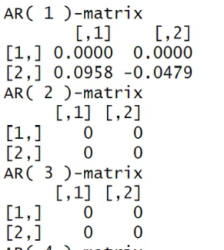
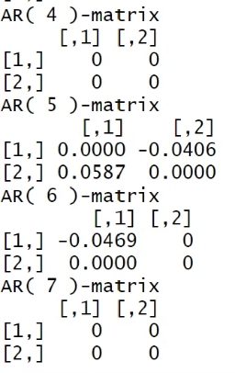
Model Estimation
In this section, we use the ARMA-EGARCH model to estimate the parameters of our chosen time series model. By incorporating both autoregressive and moving average components with an asymmetric volatility model, we aim to capture the complex dynamics of the Hong Kong transportation stocks.

Slide 19

Model Checking
After estimating the parameters of our VAR(7) model, it's important to perform model checks to assess its validity. We'll examine residuals to see whether it is white noise using Ljung-Box test. It shows that the residuals are white-noise.

Slide 20
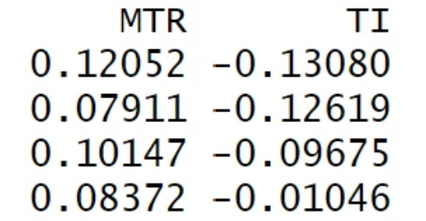
Forecasting
Now that we have successfully built and checked our VAR(7) model, it's time to use it for forecasting. We will utilize the estimated parameters and historical data to predict future values of the selected transportation stocks: MTR, and 载通. The forecasting result is as follows.

Slide 21



Thank You
Presentation
Questions
Contact
Thank you for your time and attention.
We welcome any questions or feedback you may have.
Please feel free to reach out for further discussion.

